Slide 1

US Fatal Police Shooting Analysis and Prediction
Yuan Wang
yuan.wang1@simon.rochester.edu
Yangxin Fan
yfan24@ur.rochester.edu
Notes:
Hello Everyone! This is Yuan Wang and Yangxin Fan both from university of Rochester in data science. It’s our pleasure to present our analysis in here. Our topic is US fatal police shooting analysis and prediction.

Slide 2
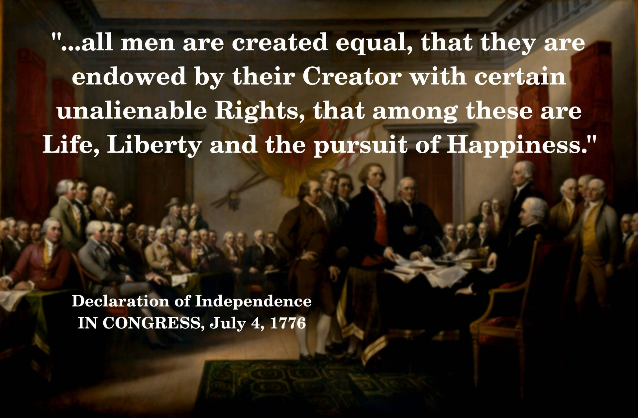
Motivation
We believe that “all men are created equal”. We want to add our two cents point of view by multi-dimensional analysis to reveal more facts to better understand the problem
Notes:
We believe that “all men are created equal”. with the rise of the police shooting reported by media, more people in the U.S. think that police use excessive force during law enforcement, especially to a specific group of people.
Our motivation is to add our two cents point of view by multi-dimensional analysis to reveal more facts to better understand the problem.

Slide 3


Content
Executive Summary
Media reporting analysis
WP Fatal police shooting dataset insight
Frequent pattern mining
Correlated variables analysis
Fatal police shooting prediction
Shooting rate prediction
Shooting race prediction
Conclusion
Notes:
Our paper is trying to address three questions:
Whether there is a media reporting bias or not?
What are the frequent pattern of fatal police shooting? What are the correlations between frequent pattern and geographics, politics, or state regulations?
Can we predict fatal police shooting rate or victims’ race by any model? If we can predict the victims’ race by a model, that’s mean there is a bias in police shooting. If not, we don’t have sufficient evidence to proof there is a bias based on WP’s data.

Slide 4
Executive Summary
Key findings:
Mainstream media disproportionally reporting fatal police shooting news by race, where Black is overreported and White is underreported.
The most significant correlated variables are state “joined US year”, “state land area”, “gun ownership rate”, and “violent crime rate”. Our best model could predict fatal police shooting rate with 88.53% correlation coefficient.
“Police basic training hour”, “# months police can work before basic training” appealed by TrainingReform[8] are negatively and weakly correlated with the fatal police shooting.
Our models show no significant evidence to conclude that racial discrimination happened during fatal police shootings recorded by the WP dataset
Notes:
Here are the highlighted key findings from our analysis:
1. There is disproportionally reporting fatal police shooting news by race from 5 selected mainstream media.
2. The most significant correlated variables are “joined US year”, “state land area”, “gun ownership rate”, and “violent crime rate”. Our best model could predict fatal police shooting rate with 88.53% correlation coefficient
3. The police training is negatively and weakly correlated with the fatal police shooting.
4. Our models show no significant evidence to conclude that racial discrimination happened during fatal police shooting recorded based on WP dataset.

Slide 5
Executive Summary
Methodology:
Media reporting analysis
FP-Growth [HPY00]
DBSCAN Clustering
WP Fatal police shooting dataset insight
T-test/ANOVA/Chi-Square testing
Correlation analysis
Fatal police shooting prediction
Kstar
K-Nearest-Neighbor
Random Forest
Gradient Boosting Machine
Multi-class Classifier
Logistic Regression
Naïve Bayes Classifier
Main Dataset:
The Washington Post: fatal police shooting dataset [2]
Kill by Police: fatal police shooting records [1]
Notes:
Here are the dataset and algorithm we used for our analysis:
The Washington Post dataset records fatal police shooting from since 2015. the kill by police website collects as many as possible fatal police shooting news from website
For frequent pattern mining, we use FP-Growth and DBSCAN
For correlation analysis, we use several hypothesis tests.
For police shooting prediction, we used

Slide 6
Content
Executive Summary
Media reporting analysis
WP Fatal police shooting dataset insight
Frequent pattern mining
Correlated variables analysis
Fatal police shooting prediction
Shooting rate prediction
Shooting race prediction
Conclusion

Slide 7
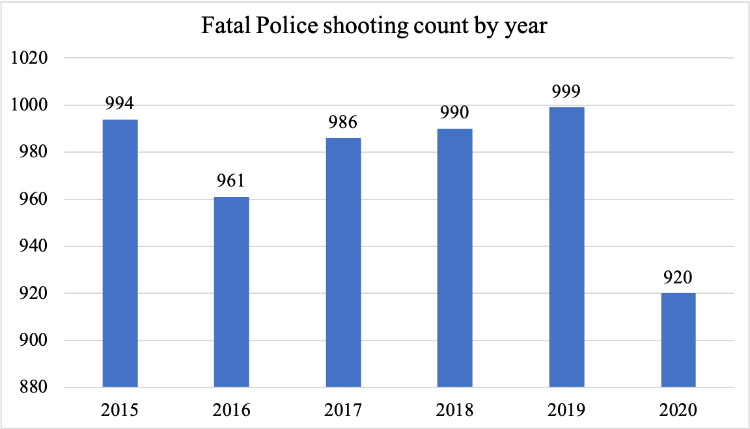
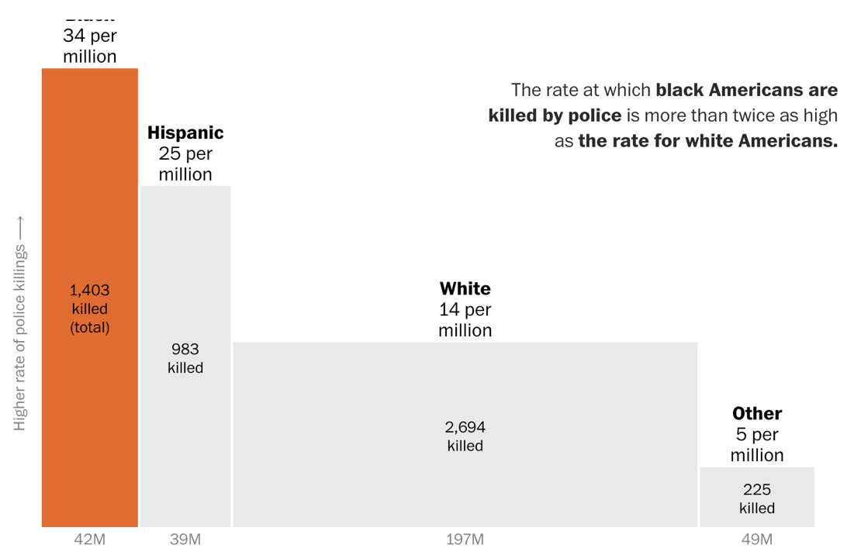
Media reporting analysis
Data from [2]
Chart from [18]
From 2015 till now, there are less than 1,000 people dead by fatal police shooting
The WP [18] chart shows that Black were killed disproportionally higher than any other race comparing to population proportion

Slide 8
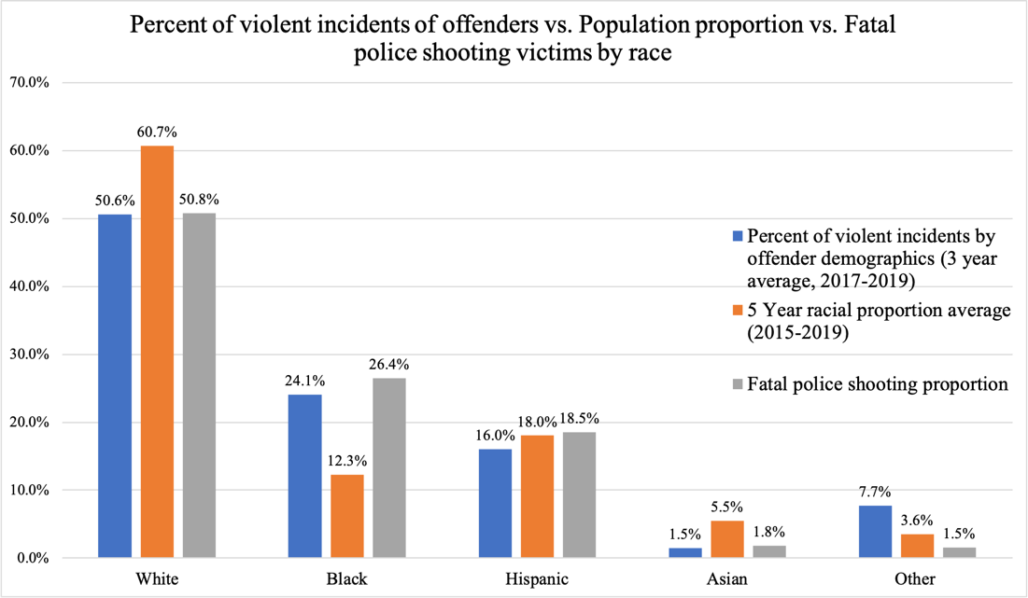
Media reporting analysis
When we add the proportion of violent incidents offenders [16] to each racial group, we see the ratios have matched each other accordingly

Slide 9
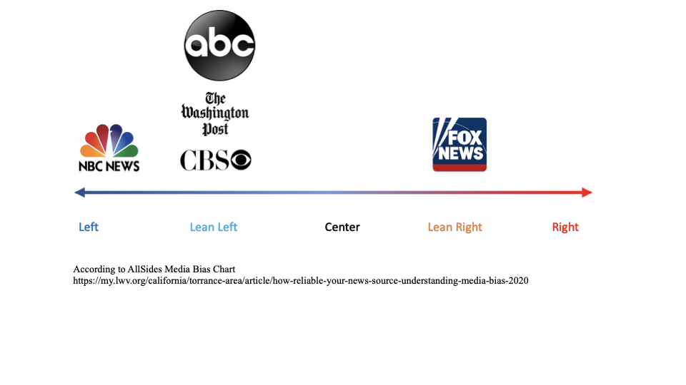
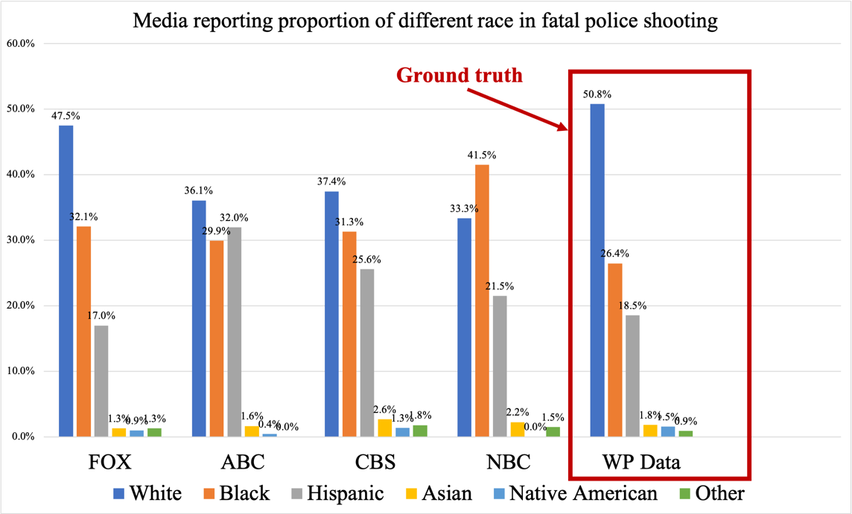
Media reporting analysis
Collected 2472 police shooting victims with known reported media and race from KBP[1],
Selected the media with over 100 fatal police shooting news reporting
Use the racial proportion of victims from WP data as the ground truth
Reporting news: ABC (244), CBS (227), and NBC (135)
All four media have different deviations on reporting the truth
Black victims were over-reported among all the media

Slide 10
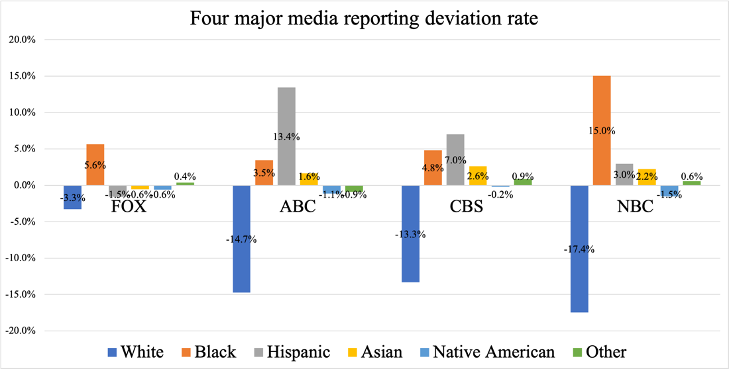
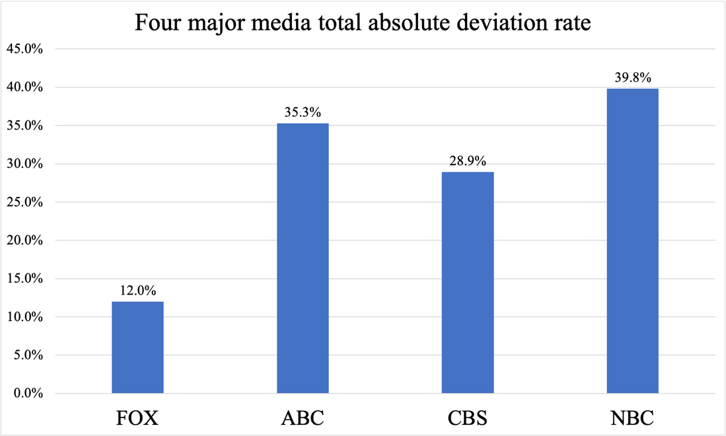
Media reporting analysis
Reporting deviation rate of media B regarding race A = R(B, A) = reported proportion of race A by media B – real proportion of race A in WP Data.
If R(B, A) < 0, media B underreports race A victims.
Else R(B, A) > 0, media B overreports race A victims.
Total absolute reporting deviation rate of media B = Σ |R(B, Ai)|, Ai is a particular race.
FOX has the least total absolute deviation rate from the WP Data. White –3.3% , Black +5.6%
NBC has the largest total absolute deviation rate from the WP Data. White -17.4%, Black +15.0%

Slide 11
Content
Executive Summary
Media reporting analysis
WP Fatal police shooting dataset insight
Frequent pattern mining
Correlated variables analysis
Fatal police shooting prediction
Shooting rate prediction
Shooting race prediction
Conclusion

Slide 12
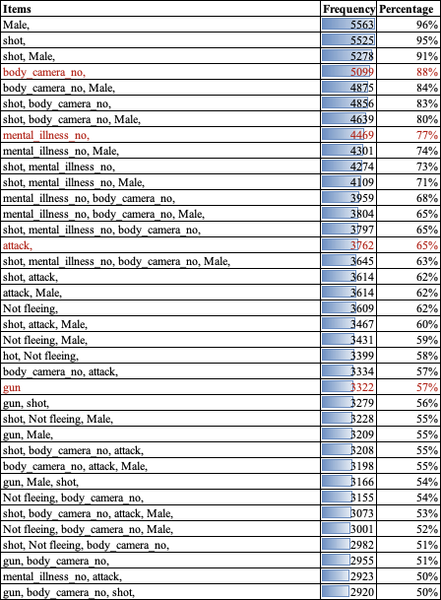
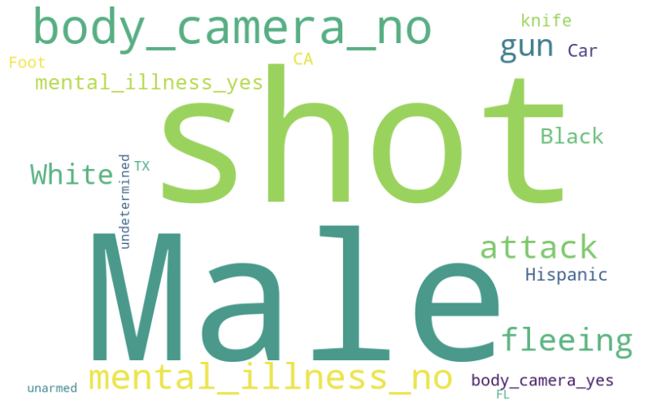
Frequent pattern mining
Frequent pattern: mini_sup = 50%, total sample size = 5818
A typical scenario: a “man” (96%) “without mental illness” (77%) uses “gun”(57%) “attack”(65%) police then get “shot”(95%) by police who does not wear “body camera” (88%)
FP-growth [HPY00],
Notes:
Based on the Washington post data from 2015 to 2020, we use FP-Growth algorithm to depict a typical scenario: 96% victims are man, which 77% have no mental illness, and 57% used gun 65% attacked police who does not wear body cameral. The 88% victims were eventually shot by police. The minimum support rate is 50% and the total sample size is 5818.
The world-cloud may give you better impression of it.

Slide 13
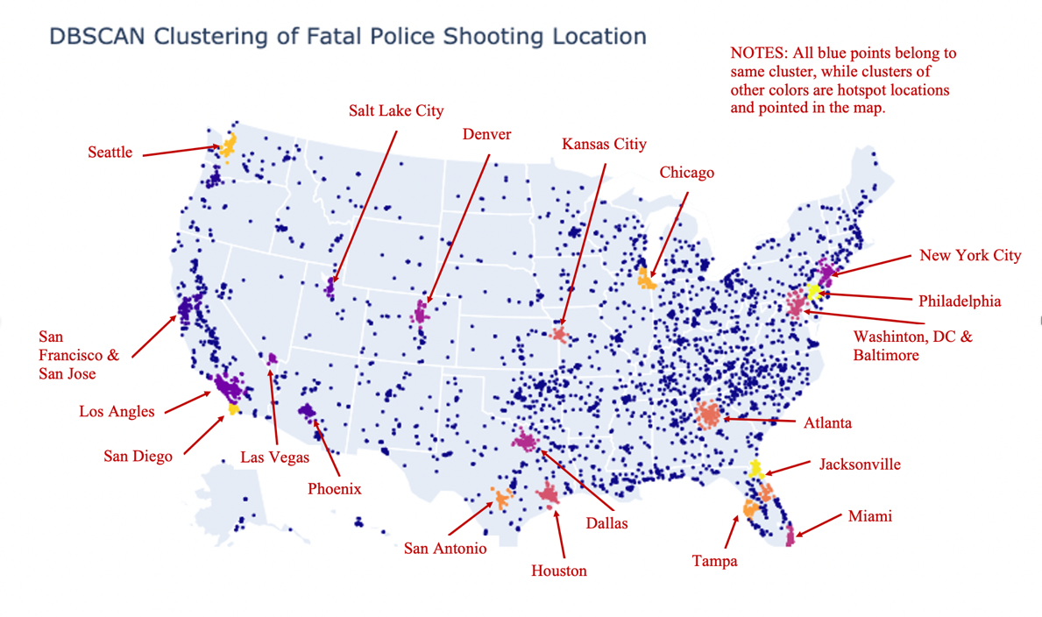
Frequent pattern mining
eps=0.5 and min_sample=50,
“California,” “Texas,” “Florida” are the top three states
“Los Angles” and “Atlanta” are two of the largest hotspots which are highly related to the large population city
DBSCAN
Notes:
Let’s display the fatal police shooting cases into the U.S. map by state. The left one shows that the top 3 largest population states are also the top 3 fatal police shooting states. BTW, New York state is the 4th large population state but has quite low shooting cases. At city level, Los angles and Atlanta are top 2 cities based on DBSCAN. You can see it from the right-side photo.

Slide 14
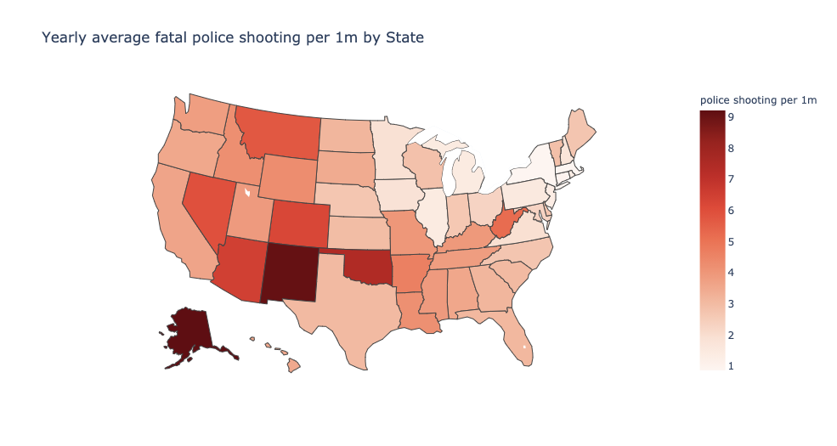
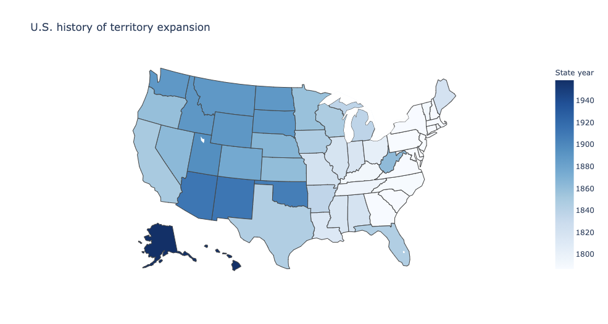
Correlated variables analysis
Correlation coefficient = 68%
New Mexico and Alaska become the top states when using average fatal police shooting per one million people (fatal police shooting rate)
Surprisingly, the color is getting darker from east to west which looks like US history territory expansion[13]. The Correlation coefficient = 68%
Notes:
In order to reduce the impacts from the state population. We then use the average fatal police shooting per 1 million people by state per year for the rest of the analysis.
Now, look at the left side photo, the darker the state, the higher average shootings in there per year. This time New Mexico and Alaska are the top 2 states. FYI, New York state is done quite good.
From this photo, what do you connect in your mind? Because I like history, I connected it with US territory expansion! Look at the new England region, the early the states joined US, the lower shooting rate it has. The correlations are 68%!

Slide 15
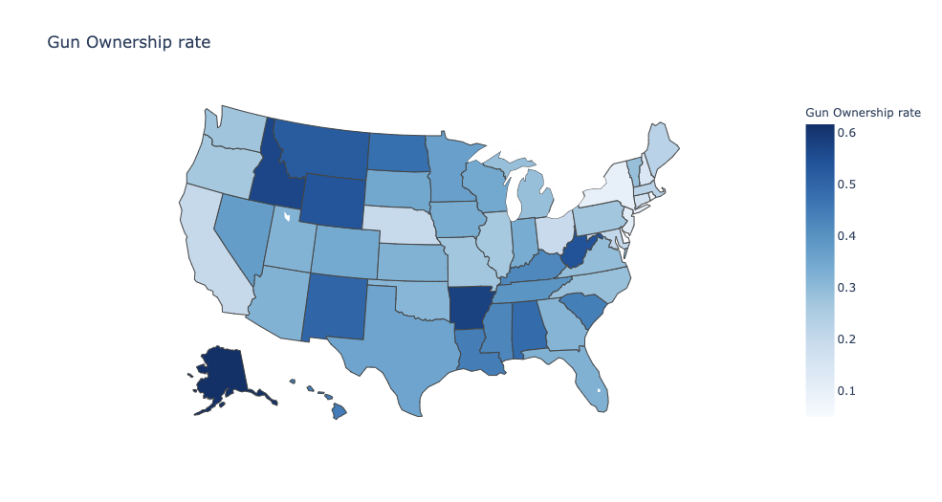
Correlated variables analysis
Correlation coefficient = 64%
The average gun ownership rate among the country is 30% [Pew], the highest state is Alaska, 61% [12]. The Correlation coefficient = 64%
57% of victims hold guns (not including other weapons), and 65% of victims chose to attack police [2]
Notes:
The next high correlation variable is gun ownership rate, which is 64%. From Pew’s report, the average gun ownership rate in the US is 30%, the highest state is Alaska which is 61%.
BTW, there are 57% victims hold guns and 65% of them chose to attack police.

Slide 16
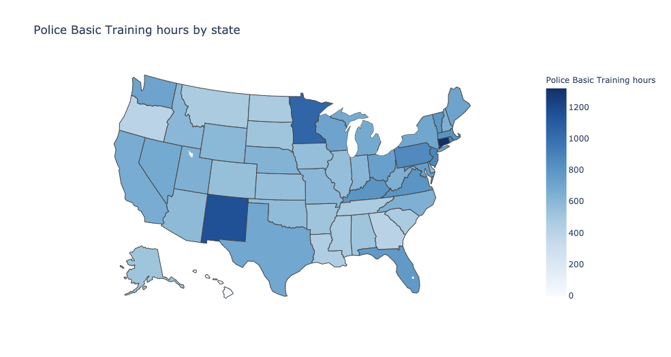
Correlated variables analysis
Correlation coefficient = -20%
Connecticut, New Mexico, and Minnesota are the top-3 states training longest hours for police [8].
The Correlation coefficient = -20% may indicate to review training rather than simply appeal for more training hours
Notes:
There is a website called “” training reform” collects each state police training information. We compared it with our data, surprisingly, the correlation is -20%! It may indicate to review the training rather than simply appeal for more training hours.

Slide 17
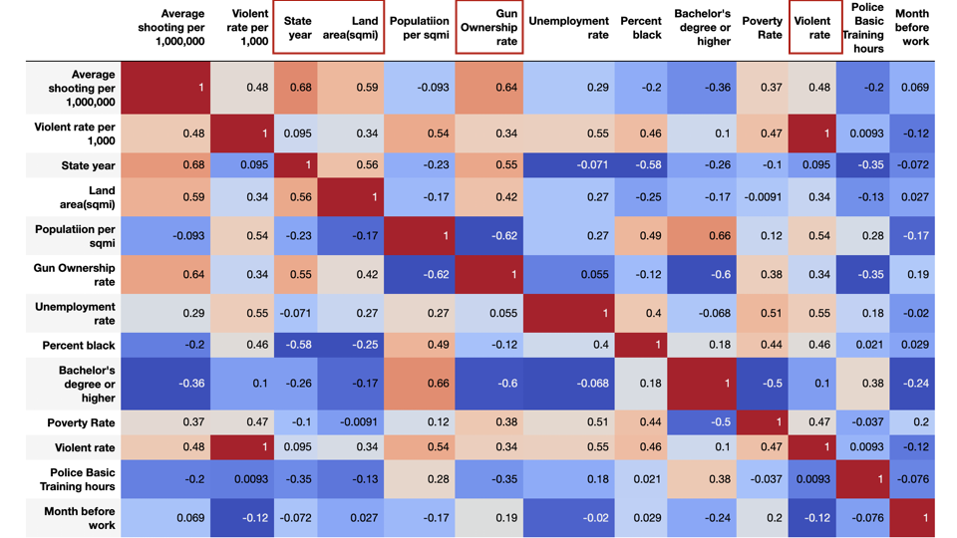
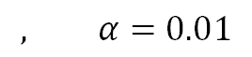
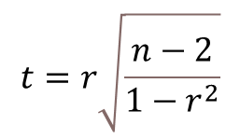
Correlated variables analysis
$$t=r\sqrt{\frac{n−2}{1−r^{2}}}$$
$$, α=0.01$$
Variable | r | n | t - statistic | p_value
State year | 0.68 | 51 | 6.4920 | 4.06E-08
Land area(sqmi) | 0.59 | 51 | 5.1152 | 5.21E-06
Violent rate | 0.48 | 51 | 3.8301 | 0.0004
Gun ownership rate | 0.64 | 50 | 5.7707 | 5.27E-07
We tested 11 variables correlation coefficient with fatal police shooting rate.
The top-4 variables are: “joined US year”: 68%, “state land area”: 59%, “gun ownership rate”: 64%, and “violent crime rate”: 48%.
Notes:
In total, we tested 11 variables correlation with fatal police shooting rate, the top 4 are “joined US year”: 68%, “state land area”: 59%, “gun ownership rate”: 64%, and “violent crime rate”: 48%.

Slide 18
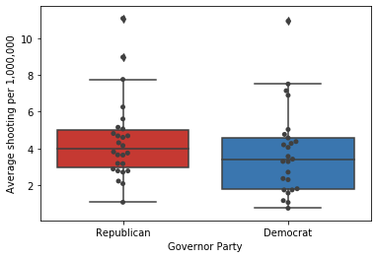
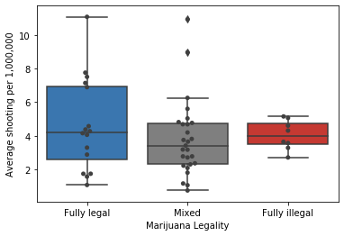
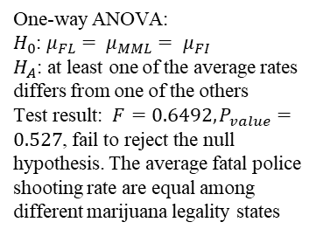
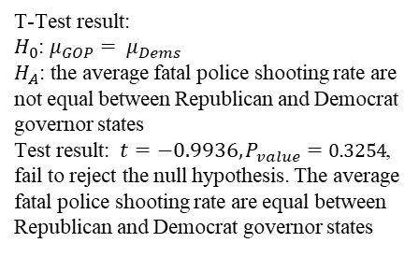
Correlated variables analysis
T-Test result:
$H_{0}$: $μ_{GOP}= μ_{Dems}$
$H_{A}$: the average fatal police shooting rate are not equal between Republican and Democrat governor states
Test result: $t=−0.9936, P_{value}=0.3254$, fail to reject the null hypothesis. The average fatal police shooting rate are equal between Republican and Democrat governor states
One-way ANOVA:
$H_{0}$: $μ_{FL}= μ_{MML}= μ_{FI}$
$H_{A}$: at least one of the average rates differs from one of the others
Test result: $F=0.6492, P_{value}=0.527$, fail to reject the null hypothesis. The average fatal police shooting rate are equal among different marijuana legality states
We tested the significance of the fatal police shooting rate by state-level Governor’s party [17] and Marijuana Legality[11]
There is no difference between those states on the fatal police shooting
Notes:
For categorical variables, we tested Governor’s party and Marijuana legality. Both show that there is no difference between those states on the police shooting. The red is GOP, and the blue is Dems for the left boxplot. On the right one, the blue is fully legal for marijuana, and red is fully illegal, the grey color represents mixed marijuana legality such as NYS did before April 2021.
The reason we chose governor party because we think it is relatively stable over the years than presidential election especially in the swing states.

Slide 19
Content
Executive Summary
Media reporting analysis
WP Fatal police shooting dataset insight
Frequent pattern mining
Correlated variables analysis
Fatal police shooting prediction
Shooting rate prediction
Shooting race prediction
Conclusion

Slide 20
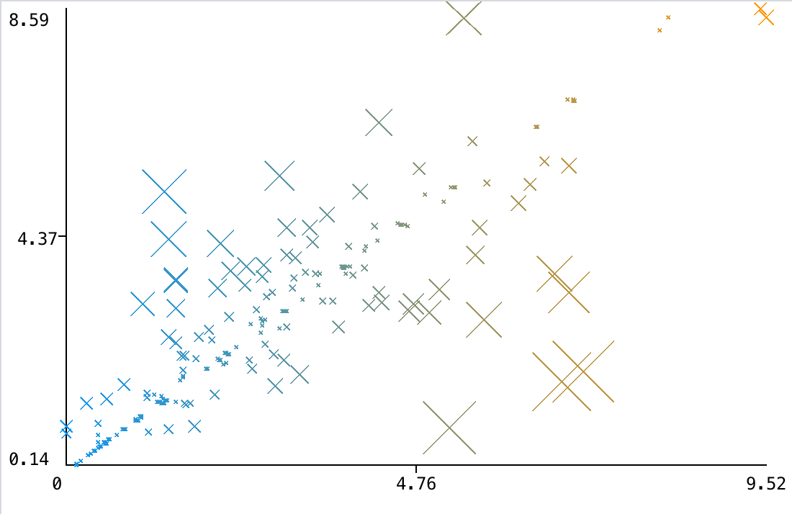
Fatal police shooting rate prediction
K* cross-validation prediction error
Algorithm | Correlation coefficient | Mean absolute error | Relative absolute error
Kstar | 0.8853 | 0.4731 | 28.04%
K-Nearest-Neighbor | 0.8517 | 0.5396 | 31.98%
Random Forest | 0.8594 | 0.6205 | 36.78%
Linear Regression | 0.4489 | 1.5238 | 90.33%
We chose the violent crime rate, land area, and gun ownership rate, state_joined_year based on their highest correlation coefficient
The best one is Kstar. It achieved 28.04% cross-validation relative absolute error and explained 88.53% variance, followed by K-Nearest-Neighbor Regression and Random Forest.
The models indicate that fatal police shooting is a complex problem

Slide 21
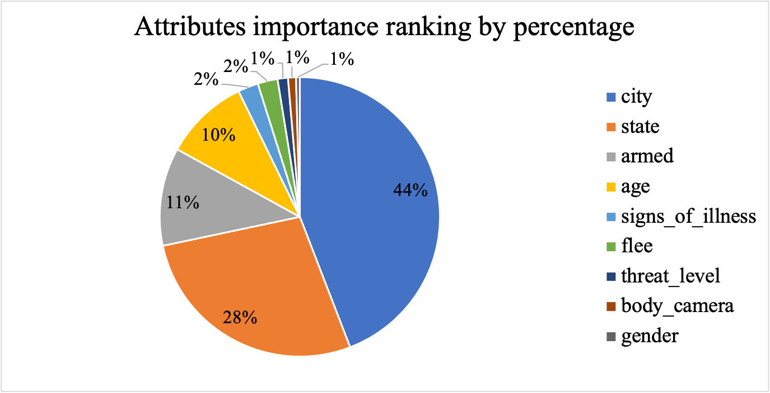
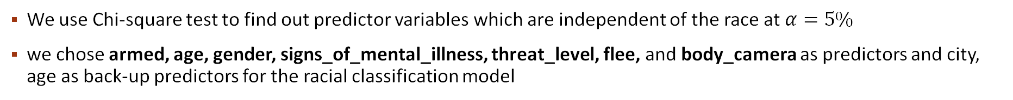
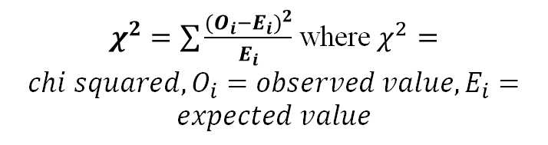
Fatal police shooting race prediction
Variables | Chi-square score | DF | P-Value
signs_of_ mental illness | 109.05 | 5 | < .00001
flee | 90.00 | 15 | < .00001
armed | 41.12 | 5 | < .00001
body_camera | 35.90 | 5 | < .00001
threat_level | 25.21 | 5 | 0.0001
gender | 18.85 | 5 | 0.0020
manner_of_death | 8.80 | 5 | 0.1171
is_gencoding_exact | 8.31 | 5 | 0.1398
$χ^{2}=\sum{\frac{{(O_{i}−E_{i})}^{2}}{E_{i}}}$ where $χ^{2}=chi squared, O_{i}=observed value, E_{i}=expected value$
We use Chi-square test to find out predictor variables which are independent of the race at $α=5\%$
we chose armed, age, gender, signs_of_mental_illness, threat_level, flee, and body_camera as predictors and city, age as back-up predictors for the racial classification model

Slide 22
Fatal police shooting race prediction
Algorithm | Precision | Recall | F1-score
Gradient Boosting Machine | 0.589 | 0.611 | 0.600
Multi-Class Classifier | 0.591 | 0.598 | 0.594
Logistic Regression | 0.588 | 0.597 | 0.592
Naïve Bayes | 0.577 | 0.588 | 0.582
Gradient Boosting Machine performs best, having 0.589 precision and 0.611 recall predicting all victims to be white (about 50% precision and recall).
There is no significant evidence shows that racial discrimination for observed fatal police shootings from WP data[2].

Slide 23
Content
Executive Summary
Media reporting analysis
WP Fatal police shooting dataset insight
Frequent pattern mining
Correlated variables analysis
Fatal police shooting prediction
Shooting rate prediction
Shooting race prediction
Conclusion
References

Slide 24
Conclusion
Mainstream media disproportionally reporting fatal police shooting news by race, which may instigate hostile sentiments between police and the public. We suggest mainstream media report all news according to the realistic.
The most significant correlated variables are state “joined US year”, “state land area”, “gun ownership rate”, and “violent crime rate”. It indicates this is a complex multi-dimensional problem.
Our Kstar model could predict fatal police shooting rate with 88.53% correlation coefficient.
Our GBM, MCC, LR, NB models show no significant evidence to conclude that racial discrimination happened during fatal police shootings recorded by the WP dataset.

Slide 25
References
https://killedbypolice.net/
https://github.com/washingtonpost/data-police-shootings
https://www.sciencedirect.com/science/article/pii/S0169023X06000218?casa_token=QYzuEqLKj-4AAAAA:VtVZ_ubtvLPaO9Cty6wN6O9XvfyhxTze45u5JD4mq1weeGJhtzlXnO2AHnEjxIVz5mUJ3Wd7jA
https://www.cs.waikato.ac.nz/ml/publications/1995/Cleary95-KStar.pdf
https://projecteuclid.org/download/pdf_1/euclid.aos/1013203451
U.S. Declaration of Independence, Thomas Jefferson, 1776
https://www.pewsocialtrends.org/2017/06/22/the-demographics-of-gun-ownership/
https://www.trainingreform.org/state-police-training-requirements
https://scholar.google.com/scholar?hl=en&as_sdt=0%2C33&q=On+Racial+Disparities+in+Recent+Fatal+Police+Shootings&btnG=
https://scholar.google.com/scholar?hl=en&as_sdt=0%2C33&q=A+Multi-Level+Bayesian+Analysis+of+Racial+Bias+in+Police+Shootings+at+the+County-Level+in+the+United+States%2C+2011%E2%80%932014&btnG=
https://disa.com/map-of-marijuana-legality-by-state
https://worldpopulationreview.com/state-rankings/gun-ownership-by-state
https://en.wikipedia.org/wiki/List_of_U.S._states_and_territories_by_area
https://ucr.fbi.gov/crime-in-the-u.s/2017/crime-in-the-u.s.-2017/topic-pages/tables/table-4
https://www.censusscope.org/us/rank_race_blackafricanamerican.html
https://www.bjs.gov/content/pub/pdf/cv19.pdf
https://en.wikipedia.org/wiki/List_of_current_United_States_governors
https://www.washingtonpost.com/graphics/investigations/police-shootings-database/

